Slide 1
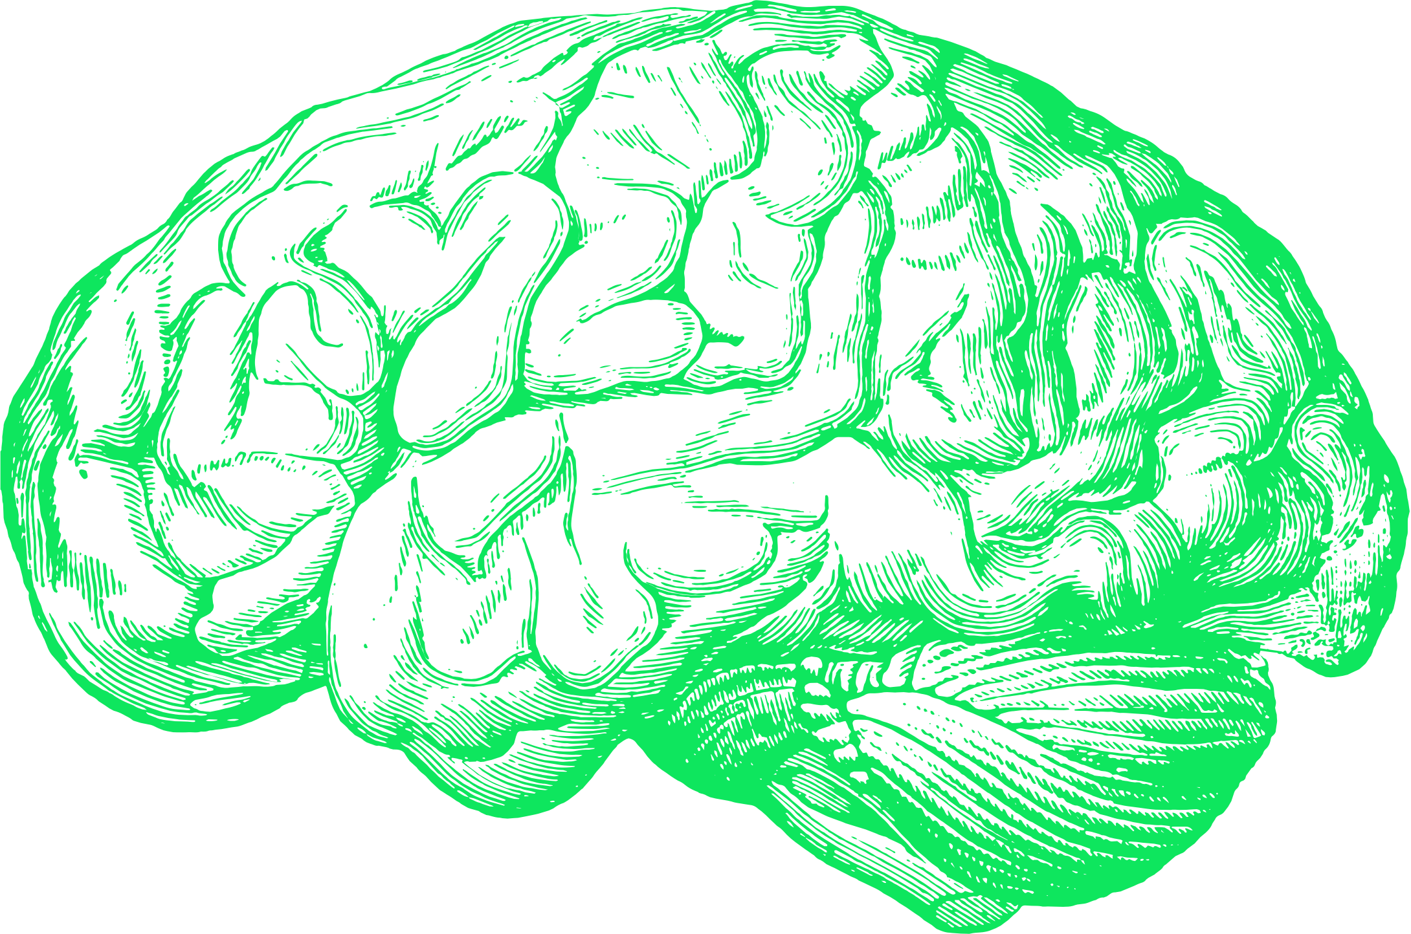
fMRI-based ADHD Detection using Machine Learning
Srinu Gopathi

Slide 2
Outline
Abstract
Introduction
Related Works
Materials
Methods
Results
Conclusion
References
Notes:
In this presentation, we will cover the Abstract and introduction of our project, Related Works, Materials and methods we used for the project, Results and Conclusion we have found and References we used.

Slide 3
Abstract
Attention-deficit/hyperactivity disorder (ADHD) is a prevalent neurodevelopmental condition, often identified during childhood due to symptoms such as inattention, hyperactivity, and impulsivity.
This study focuses on working with fMRI dataset from the ADHD-200 study to extract voxels of interest and build a ML model to predict a particular fMRI scan could be diagnosed with ADHD or be traditionally developing.
Notes:
This project focuses on automating the classification of ADHD using fMRI scans.
So, First of all what’s ADHD? Attention-deficit/hyperactivity disorder (ADHD) is a prevalent neurodevelopmental condition, often identified during childhood due to symptoms such as inattention, hyperactivity, and impulsivity.
So In this project, we used preprocessed data from the ADHD-200 study, extracted voxels of interest, and trained machine learning models to predict whether a subject is likely to be ADHD or typically developing.

Slide 4
Introduction
Currently, there is a lack of objective evaluation indicators in ADHD diagnoses [4].
Over the years, misdiagnoses in favor of/against ADHD have led to the need for developing new methods and improving old ones to aid in addressing this gap.
This study will employ a thorough analysis of the preprocessed medical imaging data, including calculating the standard deviation among voxels of the fMRI of typically developing subjects and subjects with ADHD, histogram analysis, thresholding and ML based classification.
We aim to utilize these processing techniques to automate classification and diagnosis processes, significantly increasing the accuracy of abnormality detection [4][5].
Notes:
One of the biggest challenges in ADHD diagnosis is the lack of objective clinical markers.
This leads to frequent misdiagnoses.
Our goal is to explore how Machine Learning can bring objectivity into the process.
We use standard deviation of voxel time series, thresholding, and Machine Learning classifiers to achieve this.

Slide 5
Related Works
Kim, Byunggun et al. “Finding essential parts ..[1]
  This study focuses on enhancing ADHD diagnosis by analyzing resting-state functional Magnetic Resonance Imaging (rs-fMRI) data using deep learning techniques [1].
  Feature reduction techniques highlighted 15 critical regions of interest (ROIs). They trained models using full ROIs and selected ROIs, achieving 70.6% accuracy with 15 selected ROIs compared to 68.6% accuracy with all ROIs.
"Machine Learning and ADHD Mental Health ..[2]
  In this survey, a detailed overview of machine learning models for ADHD diagnosis and their integration with neuroimaging data [2] is provided.
  Key sensing technologies discussed include fMRI and Electroencephalography (EEG). Algorithms such as Support Vector Machines (SVM), Random Forest, and Convolutional Neural Networks (CNN) were analyzed for their efficacy in extracting patterns from neuroimaging data.
Ashraf, I., Jung, S., Hur, S. et al. A systematic..[3]
  Ashraf et al.’s review analyzed studies integrating neuroimaging techniques with machine learning for ADHD diagnosis, focusing on MRI, fMRI, and functional near-infrared spectroscopy (fNIRS) [3].
  Key datasets, including the ADHD-200 and proprietary collections, were used to train models. Preprocessing steps such as normalization, feature reduction via principal component analysis, and model validation were crucial. SVM and ensemble models
Notes:
We reviewed several relevant studies. For example, Kim et al. used deep learning on fMRI with 70% accuracy. Others combined EEG and fMRI or used traditional classifiers like SVM and Random Forest.
And Ashraf et al.’s review analyzed studies integrating neuroimaging techniques with machine learning for ADHD diagnosis, focusing on MRI, fMRI, and functional near-infrared spectroscopy (fNIRS).
A key takeaway from these related works was that preprocessing and feature selection greatly influence performance.
That inspired our focus on statistically-driven voxel selection before model training.

Slide 6
Materials
The ADHD-200 dataset which comprises pre-processed resting-state fMRI data from 973 participants, categorized into two groups: Typically Developing (TD) and ADHD.
For our analysis, we utilized the NYU subset of the dataset, which includes a near-balanced distribution of 263 participants across the TD and ADHD groups.
The study employs the BOLD signal technique, a widely recognized method for measuring brain activity.
This technique is instrumental in investigating deviations in brain function associated with ADHD compared to baseline activity in healthy individuals
Notes:
For this project, we used the ADHD-200 dataset, specifically the NYU subset with 263 participants.
The data consists of resting-state fMRI scans, which are analyzed using the BOLD signal method to identify differences in brain activity between ADHD and Typically Developing subjects.

Slide 7
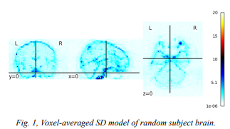
Methods: Step 1
Generating 3D Images from Standard Deviation(SD) of each Voxel’s Time Series:
  To analyze brain wave variability in our study, we began by calculating the standard deviation of time series data for different BOLD signals associated with particular voxels in the brain.
  For each voxel, the SD was computed over time, resulting in a single value per voxel that represents its temporal variability.
  This method was repeated for the entirety of each subjects’ brain, generating a single 3D image representing the SD of each subjects’ BOLD signals, illustrated by the following figure.
Notes:
The first step in out project was to quantify brain signal variability.
To achieve this we computed the standard deviation for each voxel over time.
This gave us a 3D map for each subject showing which brain regions had more or less signal fluctuation which is a potential indicator of abnormal neurological behavior.

Slide 8
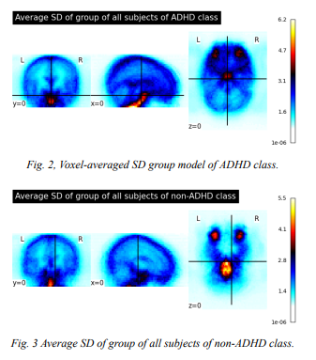
Methods: Step 2
Take Average of Standard Deviation of all the images:
  We employed both the median and the standard deviation as statistical approaches, finding that SD provided richer insights into the variability of brain signals.
  Due to the high variability in brain wave patterns, the mean proved insufficient to capture the nuanced information required for our analysis.
  To distinguish between ADHD and non-ADHD groups, we compared the SD distributions using histograms.
  We observed that certain voxels, particularly in ROIs, exhibited significant variability (high SD), while others showed little to no variation.
  This differential variability offered valuable insights into the functional dynamics of ADHD-related brain activity.
  This visualization served as a foundation for identifying differences between ADHD (illustrated in figure 2) and non-ADHD groups (illustrated in figure 3).
Notes:
As next step, we then compared average SD maps between ADHD and Typically Developing groups.
ADHD brains showed higher signal variability in known regions like the frontal lobe and thalamus.
These variations confirmed that Standard Deviation could be a meaningful feature for classification.

Slide 9
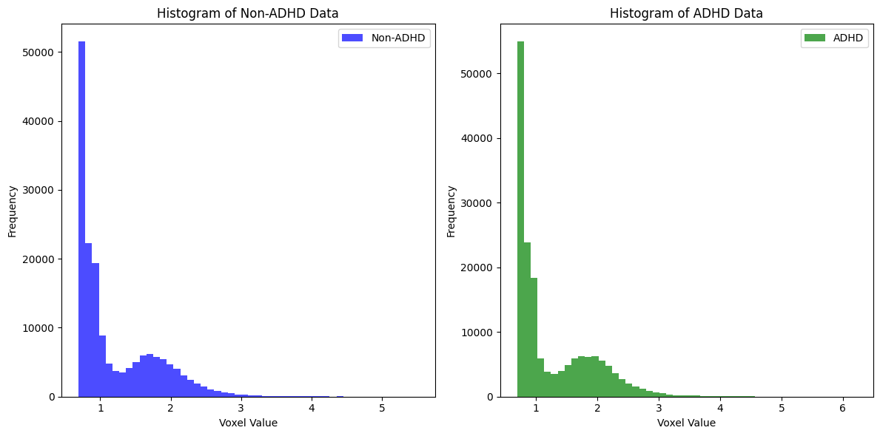
Methods: Step 2 Cont’d
Histogram Representation of SD of Voxel Values
Notes:
So this figure shows histograms of voxel-wise standard deviation (SD) values for non-ADHD subjects which is on the left side and ADHD subjects which is on the right.
Both groups have most voxels with low SD less than 1, but ADHD subjects exhibit a slightly broader spread, with more voxels showing higher variability.
This suggests increased brain signal fluctuation in ADHD, particularly in the 1 to 2 Standard Deviation range which is a key observation that supports using Standard Deviation as a discriminative feature in classification.

Slide 10
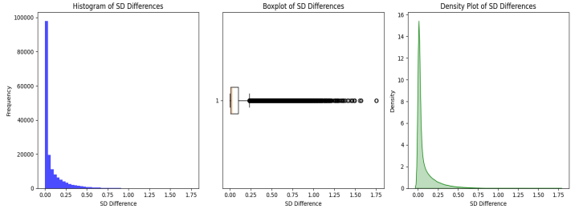
Methods: Step 3
Histograms of the generated voxels:
  The analysis of the generated voxels, based on histogram plotting, reveals that voxels with lower deviations (<1) are more numerous than those with higher deviations (>2.5).
  This pattern is consistent across both ADHD and typically developing (TD) subjects. Subsequently, the difference in voxel values between ADHD and TD subjects is calculated and visualized.
  This comparison is crucial, as the standard deviation provides meaningful insights into the hyperactivity observed in ADHD individuals.
  The BOLD signals, which reflect heightened levels of brain activity in ADHD individuals, exhibit significant variation, both high and low, when compared to TD subjects.
  The results of this analysis are presented through a histogram, box plot, and density plot to provide a comprehensive visualization of the data, illustrated in the figure.
Notes:
As the third step we analyzed the histograms of gene tarted voxels.
From the histograms we found out that most brain voxels in both ADHD and non-ADHD subjects have low standard deviation values, typically under 1.
However, when comparing the two groups, ADHD subjects display greater variability in their BOLD signals which indicates higher brain activity fluctuations which can be seen in the three graphs.

Slide 11
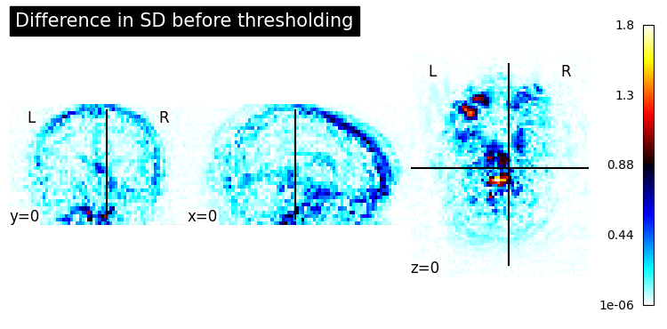
Methods: Step 3 Cont’d
The plots consistently reveal a significantly greater number of voxels within the range of {0, 0.50} standard deviation difference. This observation strongly supports the selection of this range as a threshold for voxel-based representation of subjects with and without ADHD. The plotted data further highlights a notable concentration of these voxels in the frontal lobe, thalamus, and associated regions, which are areas of interest due to their established relevance in ADHD-related neural activity and functional studies
Notes:
The most voxel differences between ADHD and non-ADHD subjects fall within the standard deviation range of 0 to 0.5, making this range an effective threshold for feature selection.
So these brain maps show that these standard deviation differences are concentrated in regions like the frontal lobe and thalamus areas known to be involved in ADHD-related brain activity.
This supports the idea that low-to-moderate standard deviation variations in these specific brain regions can be useful indicators for distinguishing ADHD from typical development.

Slide 12
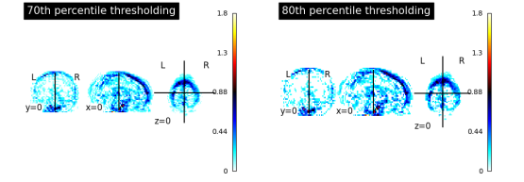
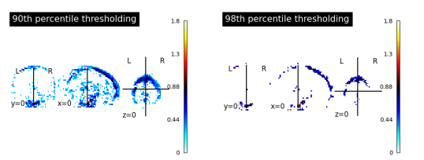
Methods: Step 3 Cont’d
To gain deeper insights into the voxels representing the study, we examine them by sampling based on percentiles. By segregating the voxels into distinct percentile ranges—such as the 70th, 80th, 90th, and 98th percentiles—we observe a progressive reduction in the number of voxels representing the brain as the threshold becomes more restrictive. These thresholds are illustrated in the next two figures.
Notes:
Then we applied percentile-based thresholding to identify the most informative brain voxels.
As we increase the threshold from the 70th to the 98th percentile, we progressively reduce the number of voxels being analyzed.
This helps eliminate low-variance regions and focus on high-activity areas more relevant to ADHD.
The images show that higher percentiles highlight fewer but more concentrated regions which likely contain stronger discriminative features for classification.

Slide 13
Methods: Step 3 Cont’d
This reduction highlights the challenge of accurately interpreting the data without a clear understanding of how many voxels effectively represent and reflect the demographic information of interest.
Thresholding based on the percentile value of the standard deviation initially appeared promising for segmenting the image.
Consequently, it becomes essential to implement a thresholding mechanism to ensure the dataset is more representative and free of extraneous or irrelevant information, rather than relying on the full image, which may include noise or uninformative data points.
Since determining the threshold is not feasible through manual adjustments, this limitation highlighted the need for an automated, statistically driven thresholding method capable of dynamically selecting the most suitable threshold value.
Such a method would ensure consistent and accurate segmentation by leveraging statistical analysis to account for variations in image properties and voxel distributions.
Notes:
From the previous step we found out that as higher percentiles reduce the number of selected voxels, it becomes harder to know which voxels truly reflect meaningful brain activity.
Manually deciding on a threshold can be unreliable, so a statistically driven method like Otsu’s thresholding is necessary.
Otsu’s thresholding automatically determines the optimal cutoff which helps us exclude noisy or uninformative data and ensuring our dataset is both clean and representative for machine learning classification.

Slide 14
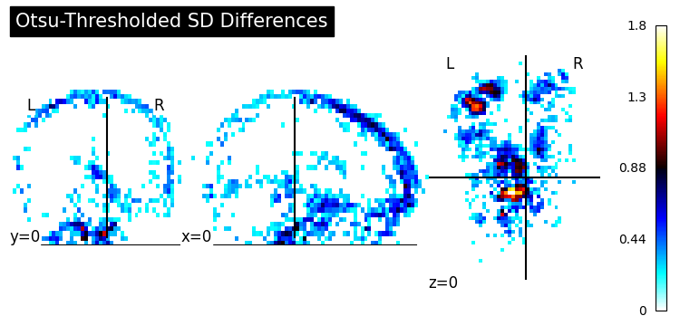
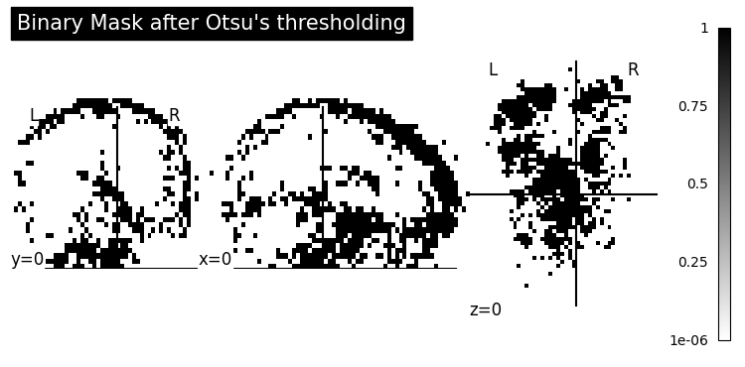
Methods: Step 4
Otsu’s thresholding of the difference voxels:
  In finding the optimal thresholding method, we utilized Otsu’s thresholding, a robust algorithm that segments data by minimizing intraclass variance while maximizing interclass variance.
  Unlike standard thresholding, which requires manual specification of a threshold value, Otsu’s method automatically calculates the optimal threshold for separating signal from background.
  In our case, performing Otsu’s thresholding to the 3D image gave us Otsu's threshold being: 0.1990634563844651, approximately 0.199, mathematically corresponding to the 87th percentile.
  The respective generated histogram is illustrated below in the figure.
Notes:
As the next step we applied Otsu’s algorithm to decide optimal cutoff.
Unlike manual methods, Otsu’s algorithm finds the threshold that best separates meaningful signal from background noise by minimizing within-class variance. In our case, it identified an optimal threshold of approximately 0.199 which corresponds to the 87th percentile.
This value effectively isolates voxels with higher variability, which are more likely to be relevant for ADHD classification.
The brain maps below show how this threshold highlights key regions, while the binary mask illustrates which voxels were retained.

Slide 15
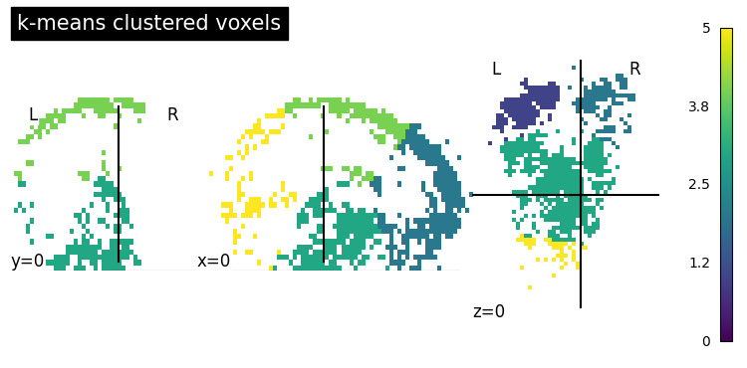
Methods: Step 5
K-Means Clustered Voxels:
  Visualizing brain areas affected by ADHD is crucial for differentiating ADHD and non-ADHD groups.
  While some voxels may appear visually adjacent, they are not necessarily connected functionally or structurally.
  To better understand the connectivity, we applied a k-means clustering algorithm, which grouped the voxels into six distinct brain segments based on calculated distances.
  This approach segregated voxels that were spatially or functionally closer from those that were further apart, providing a clearer picture of clustered regions of interest.
Notes:
Then we used K-means clustering to group voxels into functionally distinct brain regions.
Even if some voxels appear close visually, they might not be functionally related.
To better understand ADHD-related activity, we clustered the most informative voxels into six groups based on spatial and statistical similarity.
This helped us identify localized brain segments that are more active or variable in ADHD subjects, improving our ability to visualize and interpret the brain regions most impacted by the disorder.

Slide 16
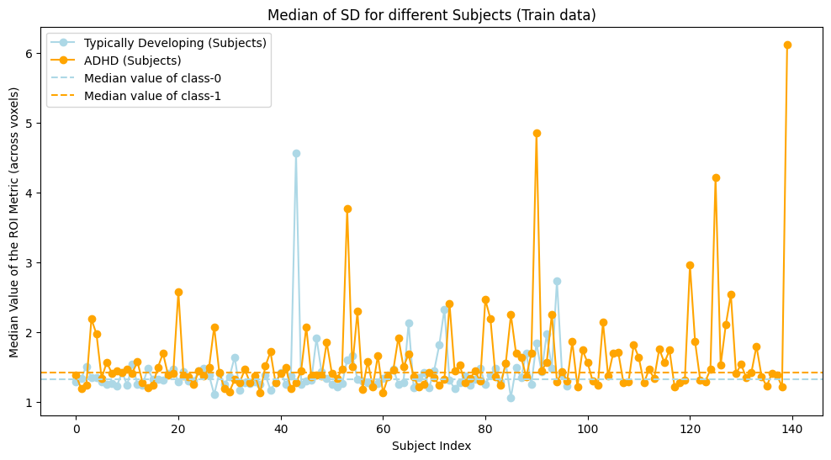
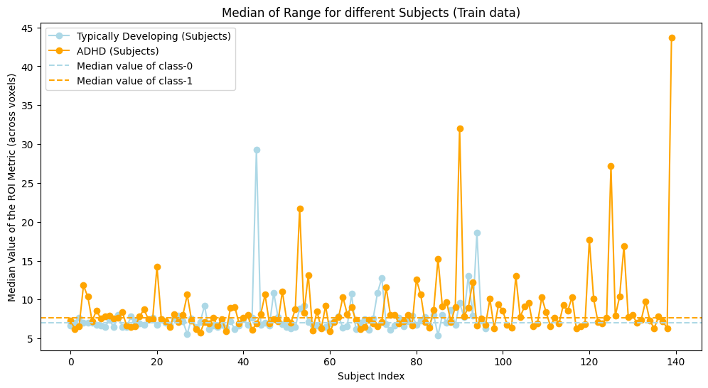
Methods: Step 6
Extracting Voxel Features :
  To analyze the brain data effectively, we saved the point values for the voxels of interest, focusing on a total of 22,404 voxels identified as significant for differentiating ADHD and non-ADHD groups.
  We then extracted features exclusively from these voxel values to streamline the analysis.
  Key features were identified to provide insights into the variability and characteristics of the brain signals.
  To extract these features across all datasets, we developed a function that processes the data for each subject.
  This function analyzed the BOLD signals for the selected voxels, exploring various metrics such as the range, median value, and standard deviation. These metrics provided insight into ADHD brain patterns having higher-than-average variance in the BOLD signals, as shown in the below figures.
Notes:
From each selected voxel, we extracted statistical features like standard deviation, range, and median. These time-series-derived features were then compiled into a flat dataset, which we used to train our machine learning models.

Slide 17
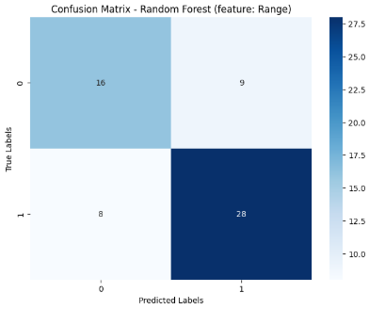
Methods: Step 7
Random Forest – Range Feature:
We trained a Random Forest classifier using range values extracted from voxel-level BOLD signals.
The model showed an accuracy of 72.1%, indicating reasonable overall performance.
Its precision of 75.7% means that about three-fourths of its ADHD predictions were correct.
The recall, at 77.8%, shows that it identified most of the actual ADHD cases.
The F1 score, which balances precision and recall, was 76.7%.
The confusion matrix indicates it correctly classified 28 ADHD cases and 16 typically developing individuals, while misclassifying 17 subjects (9 false positives, 8 false negatives).
Notes:
So as the next steps, we applied Random Forest algorithm on the raw range features.
The Random Forest model achieved 72.1% accuracy.
Its recall was high at 77.8%, meaning it correctly identified most ADHD cases
The confusion matrix indicates it correctly classified 28 ADHD cases and 16 typically developing individuals, while misclassifying 17 subjects (9 false positives, 8 false negatives).

Slide 18
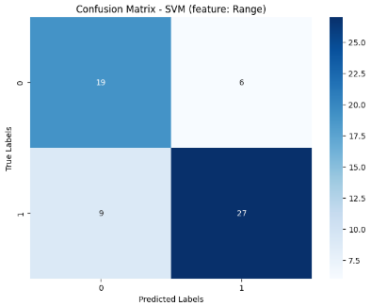
Methods: Step 7 Cont’d
SVM – Range Feature
Using the same range-based features, we trained a Support Vector Machine (SVM) with a linear kernel.
This model outperformed Random Forest in overall accuracy, scoring 75.4%.
More notably, it achieved a high precision of 81.8%, suggesting it was very reliable in identifying ADHD subjects with fewer false positives.
The recall was slightly lower at 75.0%, meaning it correctly identified three-fourths of ADHD cases.
The F1 score of 78.3% reflects a strong balance between precision and recall.
The confusion matrix showed slightly fewer errors compared to Random Forest, with 6 false positives and 9 false negatives.
Notes:
Then we applied SVM to the same raw range features.
The SVM model outperformed Random Forest on range data.
It achieved 75.4% accuracy, with 81.8% precision and 78.3% F1 score.
The confusion matrix shows SVM has 6 false positives and 9 false negatives errors.
.This means SVM made fewer false predictions and had a better overall balance.

Slide 19
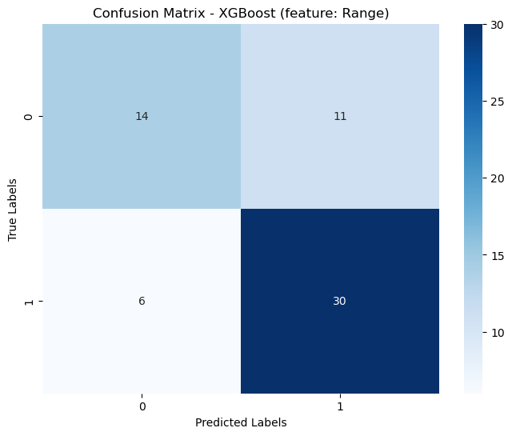
Methods: Step 7 Cont’d
XGB – Range Feature
Using the same range-based features, we trained an XGBoost classifier.
This model achieved an overall accuracy of 72.1%, slightly lower than SVM but with a stronger recall.
It attained a precision of 73.2%, indicating a reasonably low rate of false positives in identifying ADHD subjects.
The recall was high at 83.3%, meaning it successfully captured the majority of ADHD cases.
With an F1 score of 77.9%, the model demonstrated a solid balance between precision and recall.
The confusion matrix reflected this performance, showing 6 false negatives and 11 false positives, slightly more conservative than SVM but better at capturing true ADHD instances.
Notes:
Then we applied XGBoost to the same raw range features.
The XGBoost model achieved 72.1% accuracy, slightly lower than SVM but with stronger recall.
It reached 73.2% precision and a higher recall of 83.3%, resulting in a solid F1 score of 77.9%.
The confusion matrix shows XGBoost had 11 false positives and 6 false negatives.
This means XGBoost was more sensitive to ADHD cases and captured more true positives, though at the cost of a few extra false alarms.

Slide 20
Methods: Step 7 Cont’d
Random Forest vs SVM – Range Feature
Model | Accuracy | Precision | Recall | F1 Score
Random Forest | 0.721 | 0.757 | 0.778 | 0.767
SVM | 0.754 | 0.818 | 0.750 | 0.783
XGB | 0.721 | 0.732 | 0.833 | 0.779
Notes:
In direct comparison, SVM achieved the highest accuracy and precision, making it the most balanced model overall.
XGBoost had the highest recall, meaning it was better at detecting ADHD cases.
Random Forest performed consistently but was outperformed by SVM and XGBoost in key metrics.

Slide 21
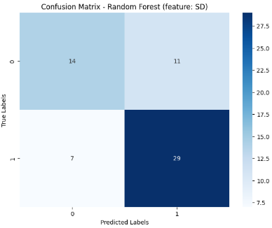
Methods: Step 7 Cont’d
Random Forest – SD Feature
We then trained the Random Forest model again, this time using the standard deviation (SD) of voxel time series as input features.
The model achieved an accuracy of 70.4%, slightly lower than its range-based version. It excelled in recall (80.5%), meaning it correctly identified a high proportion of ADHD cases.
Precision was moderate at 72.5%, which means more false positives were present compared to SVM.
The F1 score was 76.3%, showing solid balance overall.
This suggests that Random Forest, when fed SD features, became more sensitive to ADHD detection but at the cost of making more incorrect ADHD predictions.
Notes:
As a next steps we used Standard deviation features.
Using Standard deviation features, Random Forest achieved 70.4% accuracy with high recall (80.5%).
It was good at detecting ADHD but made more false positives, which impacted its precision and led to an F1 score of 76.3%.

Slide 22
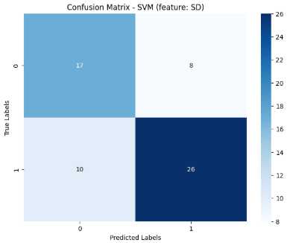
Methods: Step 7 Cont’d
SVM – SD Feature
When trained on SD features, the SVM model achieved the same accuracy (70.4%) as Random Forest but behaved differently.
It had higher precision (76.5%) and lower recall (72.2%) compared to Random Forest, indicating that it was more conservative in predicting ADHD, with fewer false positives but more false negatives.
The F1 score came out to 74.3%, a bit lower than Random Forest in this setup.
While the model was not the best at detecting every ADHD case, its higher precision suggests it made more trustworthy positive predictions.
Notes:
When trained on SD features, the SVM model achieved the same accuracy (70.4%) as Random Forest but behaved differently.
It had higher precision (76.5%) and lower recall (72.2%) compared to Random Forest, indicating that it was more conservative in predicting ADHD, with fewer false positives but more false negatives.
It was more conservative than Random Forest, avoiding mislabeling but missing some ADHD cases.

Slide 23
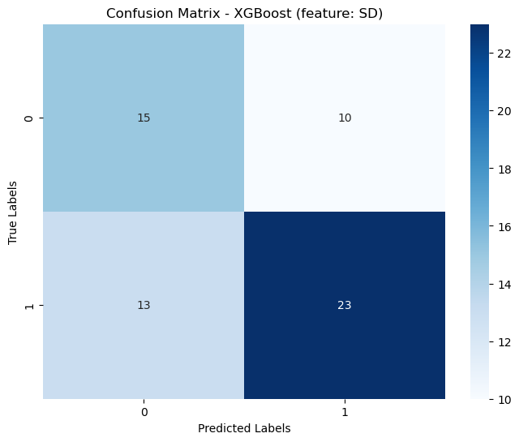
Methods: Step 7 Cont’d
XGBoost – SD Feature
When trained on standard deviation (SD) features, the XGBoost model achieved an accuracy of 62.3%, which is notably lower than SVM and Random Forest on the same features.
It attained a precision of 69.7%, indicating that nearly 7 out of 10 ADHD predictions were correct.
The recall was 63.9%, suggesting that the model missed over one-third of actual ADHD cases.
Its F1 score stood at 66.7%, reflecting a moderate trade-off between precision and recall.
As seen in the confusion matrix, it made 13 false negatives and 10 false positives, showing less reliability in both identifying ADHD and avoiding incorrect labels compared to other models using SD features.
Notes:
Then we applied XGBoost to the SD features.
The model achieved 62.3% accuracy, which was lower than both SVM and Random Forest.
It had 69.7% precision and 63.9% recall, resulting in an F1 score of 66.7%.
The confusion matrix shows 10 false positives and 13 false negatives.
This means XGBoost struggled to balance accuracy and sensitivity when using SD features.

Slide 24
Methods: Step 7 Cont’d
Random Forest vs SVM vs XGB – SD Feature
Model | Accuracy | Precision | Recall | F1 Score
Random Forest | 0.705 | 0.725 | 0.806 | 0.763
SVM | 0.705 | 0.765 | 0.722 | 0.743
XGB | 0.623 | 0.697 | 0.638 | 0.666
Notes:
Comparing the three models with SD features, Random Forest had the best recall and F1 score, making it the most effective at identifying ADHD cases while maintaining balance.
SVM had the highest precision, meaning it was more accurate when predicting ADHD but missed more cases than RF.
XGBoost performed the worst overall, with the lowest accuracy, recall, and F1 score.
Overall, Random Forest was the strongest performer for ADHD detection using standard deviation features.

Slide 25

Methods: Step 7 Cont’d
PCA + Random Forest (Range Feature)
To reduce the dimensionality of our high-dimensional voxel range feature set, we applied Principal Component Analysis (PCA), reducing 22,404 features down to 129 while preserving 95% of the original variance.
When we trained a Random Forest classifier on this PCA-transformed dataset, it achieved an accuracy of 72.1% — consistent with the performance prior to PCA.
However, we observed a notable improvement in recall, which rose to 88.0%, indicating the model became significantly better at identifying ADHD cases.
Precision remained strong at 74.4%, and the F1 score improved to 77.3%, reflecting a well-balanced model that benefited from dimensionality reduction without sacrificing performance.
Notes:
We then applied Principal Component Analysis to reduce the dimensionality of our high-dimensional voxel range feature set which reducednumber of features from 22,404 down to 129 while preserving 95% of the original variance.
When we trained a Random Forest classifier on this PCA-transformed dataset, its recall jumped to 88.0% while maintaining its accuracy at 72.1%.
This shows PCA helped the model become more sensitive to ADHD cases without sacrificing performance.

Slide 26

Methods: Step 7 Cont’d
PCA + SVM (Range Feature)
Using the same PCA-transformed data, we trained a Support Vector Machine (SVM) with a linear kernel.
In this case, model performance slightly dropped compared to using the raw range features. The SVM achieved an accuracy of 68.9%, with a precision of 74.3%, recall of 72.2%, and an F1 score of 73.2%.
While these numbers indicate that the model still performed reasonably well, the reduced feature set seemed to slightly hinder SVM’s ability to generalize as effectively.
The confusion matrix showed a small increase in false negatives, suggesting that SVM became more conservative after PCA and missed more ADHD cases than before.
Notes:
Using the same PCA-transformed data, we trained a Support Vector Machine (SVM) with a linear kernel.
In this case, model performance slightly dropped compared to using the raw range features. The SVM achieved an accuracy of 68.9%, with a precision of 74.3%, recall of 72.2%, and an F1 score of 73.2%.
This suggests that SVM may have relied more on the full feature space and didn’t benefit much from dimensionality reduction here

Slide 27
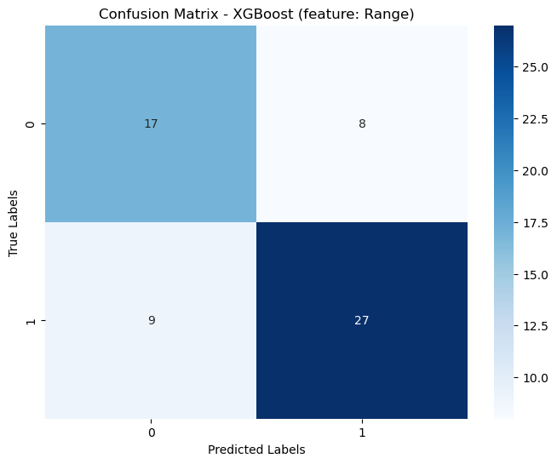
Methods: Step 7 Cont’d
PCA + XGBoost (Range Feature)
We trained an XGBoost classifier on the PCA-transformed range-based features.
The model achieved a testing accuracy of 72.1%, closely matching the performance on non-PCA features.
With a precision of 77.1% and recall of 75.0%, the model maintained a strong ability to identify ADHD cases while minimizing false positives.
The F1 score of 76.1% highlights a solid balance between precision and recall, even after dimensionality reduction.
The confusion matrix confirmed a good performance balance, with only 8 false positives and 9 false negatives, suggesting PCA preserved the essential signal for XGBoost’s decision-making.
Notes:
Then we applied XGBoost to PCA-transformed range features.
The model achieved 72.1% accuracy, similar to its non-PCA version.
It had 77.1% precision, 75.0% recall, and a solid F1 score of 76.1%.
The confusion matrix shows 8 false positives and 9 false negatives.
This suggests PCA preserved useful signal, and XGBoost maintained strong balanced performance even after dimensionality reduction.

Slide 28
Methods: Step 7 Cont’d
Random Forest vs SVM vs XGB – Range Feature with PCA
Model | Accuracy | Precision | Recall | F1 Score
Random Forest | 0.721 | 0.744 | 0.806 | 0.773
SVM | 0.689 | 0.743 | 0.722 | 0.732
XGB | 0.7213 | 0.7714 | 0.750 | 0.760
Notes:
Comparing the models with PCA-applied range features, Random Forest had the highest recall (80.6%) and F1 score (77.3%), making it the most sensitive and balanced model.
XGBoost achieved the best precision (77.1%) and a strong F1 score (76.0%), showing solid all-around performance.
SVM performed the weakest in this setup, with the lowest accuracy and F1 score.
Overall, Random Forest showed the strongest results after PCA, especially for detecting ADHD cases.

Slide 29
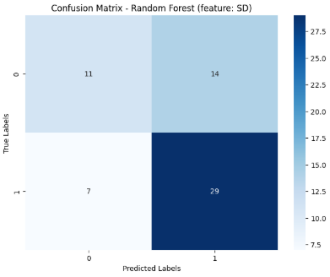
Methods: Step 7 Cont’d
PCA + Random Forest (SD Feature)
To evaluate how dimensionality reduction affects model performance using standard deviation (SD) features, we applied PCA to the dataset, reducing the number of features from 22,404 to 135 while retaining 95% of the total variance.
Training the Random Forest classifier on this PCA-transformed data resulted in an accuracy of 65.6%, which is lower than its performance without PCA.
However, recall remained high at 88.0%, showing the model still effectively detected ADHD cases.
Precision dropped to 67.4%, indicating an increase in false positives.
The F1 score settled at 73.4%, reflecting that although the model was sensitive to detecting ADHD, it lost some balance due to reduced specificity.
Notes:
To evaluate how dimensionality reduction affects model performance using standard deviation features, we applied PCA to the dataset which reduced the number of features from 22,404 to 135 while retaining 95% of the total variance.
Using PCA-transformed Standard Deviation features, Random Forest had a high recall (88.0%) but lower precision, resulting in a 65.6% accuracy and 73.4% F1 score.
It became highly sensitive but also generated more false positives.

Slide 30
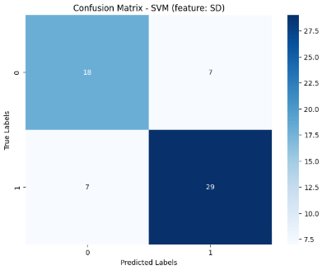
Methods: Step 7 Cont’d
PCA + SVM (SD Feature)
The Support Vector Machine model trained on PCA-transformed SD features performed notably better than Random Forest in this setup.
It achieved an accuracy of 77.0%, with both precision and recall at 80.5%, and an impressive F1 score of 80.5% as well.
The confusion matrix showed a low number of both false positives and false negatives, suggesting that SVM maintained a strong balance between correctly identifying ADHD subjects and avoiding incorrect predictions.
This indicates that SVM not only handled the dimensionality reduction well but may have even benefited from it when SD features were used.
Notes:
The Support Vector Machine model trained on PCA-transformed Standard Deviation features performed notably better than Random Forest in this setup.
Support Vector Machine model trained on PCA-transformed Standard Deviation features performed the best overall with 77.0% accuracy, with 80.5% precision, recall and F1 score.
It showed excellent balance and was the most effective model in our study.

Slide 31
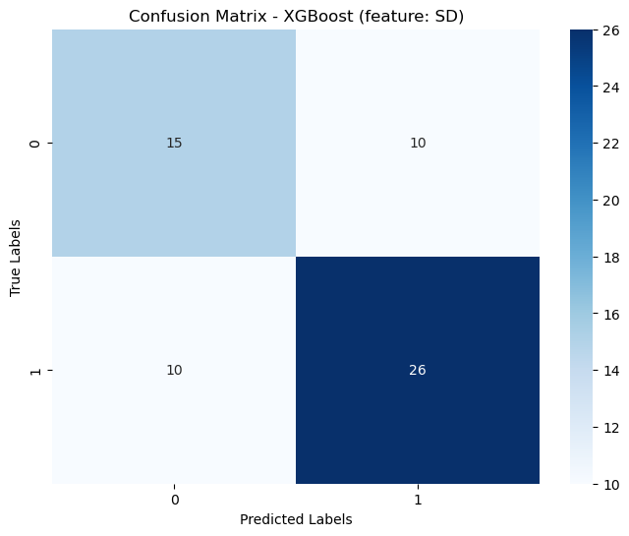
Methods: Step 7 Cont’d
PCA + XBG (SD Feature)
The XGBoost model trained on PCA-transformed standard deviation (SD) features showed moderate performance.
It achieved a testing accuracy of 67.2%, which was lower than both the SVM and Random Forest models in the same setup.
The model recorded a precision of 72.2% and a recall of 72.2%, reflecting a balanced but not exceptional classification ability.
Its F1 score matched at 72.2%, indicating consistent—but limited—performance across all evaluation metrics.
While the model handled the dimensionality reduction reasonably well, it didn’t show any improvement over the non-PCA version, suggesting that PCA may have removed some useful discriminative information for SD-based features in this case.
Notes:
Then we applied XGBoost to PCA-transformed SD features.
The model achieved 67.2% accuracy, with both precision and recall at 72.2%, resulting in a balanced but moderate F1 score.
The confusion matrix shows 10 false positives and 10 false negatives.
Performance was stable, but no improvement over the non-PCA version—suggesting PCA may have removed important SD-based signal

Slide 32
Methods: Step 7 Cont’d
Random Forest vs SVM – SD Feature with PCA
Model | Accuracy | Precision | Recall | F1 Score
Random Forest | 0.656 | 0.674 | 0.806 | 0.734
SVM | 0.771 | 0.806 | 0.806 | 0.806
XGB | 0.6721 | 0.7222 | 0.7222 | 0.7222
Notes:
In summary, while Random Forest retained high recall after PCA was applied to SD features, its precision dropped, leading to a lower F1 score of 73.4%.
SVM, on the other hand, achieved the best overall performance with 77.1% accuracy and consistent 80.6% precision, recall, and F1 score.
XGBoost performed moderately, with balanced but lower scores across all metrics.
These results show that SVM is the most effective model when working with PCA-transformed SD features for ADHD classification.

Slide 33
Results
SVM with range features (no PCA) achieved the best F1 score (78.3%) before dimensionality reduction, while Random Forest had slightly better recall (77.8%).
After applying PCA, XGBoost with range features maintained strong performance with an F1 score of 76.1%, though SVM's performance slightly declined.
With SD features, the SVM with PCA model was originally the top performer, but based on updated results, XGBoost with PCA-transformed SD features achieved a moderate and consistent F1 score of 72.2%.
However, in the overall comparison, SVM with PCA-transformed SD features still stands out as the best-performing model, offering the highest accuracy (77.0%), precision, recall, and F1 score (all 80.5%), making it the most reliable for balanced ADHD classification.
Notes:
In overall, SVM with range features (no PCA) had the highest F1 score before dimensionality reduction, while Random Forest had slightly better recall.
After PCA, XGBoost with range features performed well, but SVM’s performance declined.
With SD features, SVM with PCA showed the most consistent and balanced results.
Overall, SVM with PCA-transformed SD features was the best model, achieving 77.0% accuracy, and 80.5% across all major metrics, making it the most reliable for ADHD classification.

Slide 34
Conclusion
We conclude that the features extracted from the identified voxels of interest—standard deviation (SD) and range are effective in classifying ADHD subjects with meaningful accuracy.
Among the models tested, Support Vector Machine (SVM) consistently demonstrated strong performance, particularly when trained on PCA-transformed SD features, achieving the highest accuracy and balance across all metrics.
This reinforces the strength of combining voxel-level statistical features with advanced machine learning algorithms for reliable classification.
Our findings underscore the robustness of this approach in capturing neuroimaging patterns linked to ADHD and highlight its potential to support more objective, data-driven diagnostic tools for ADHD through techniques such as SVM and XGBoost.
Notes:
In conclusion, we found that standard deviation and range are effective features for classifying ADHD when combined with machine learning.
SVM stood out, especially with PCA-transformed SD features, delivering the most balanced and accurate results.
This supports the effectiveness of combining statistical voxel features with models like SVM and XGBoost.
Overall, our approach shows strong potential for building more objective, data-driven ADHD diagnostic tools using neuroimaging and ML.

Slide 35
References
[1] Kim, Byunggun et al. “Finding essential parts of the brain in rs-fMRI can improve diagnosing ADHD by Deep Learning.” (2021).
[2] C. Nash, R. Nair and S. M. Naqvi, "Machine Learning and ADHD Mental Health Detection - A Short Survey," 2022 25th International Conference on Information Fusion (FUSION), Linköping, Sweden, 2022, pp. 1-8, doi: 10.23919/FUSION49751.2022.9841277.
[3] Ashraf, I., Jung, S., Hur, S. et al. A systematic literature review of neuroimaging coupled with machine learning approaches for diagnosis of attention deficit hyperactivity disorder. J Big Data 11, 140 (2024). https://doi.org/10.1186/s40537-024-00998-3
[4] Cao, Meng et al. “Machine learning in attention-deficit/hyperactivity disorder: new approaches toward understanding the neural mechanisms.” Translational psychiatry vol. 13,1 236. 1 Jul. 2023, doi:10.1038/s41398-023-02536-w
[5] Zhang-James, Yanli et al. “Machine Learning and MRI-based Diagnostic Models for ADHD: Are We There Yet?.” Journal of attention disorders vol. 27,4 (2023): 335-353. doi:10.1177/10870547221146256
[6] P. R, R. Komarina, P. A. Priya and U. R. K, "MRI Segmentation of Human Brain for Diagnosis of ADHD," 2023 International Conference on Recent Advances in Electrical, Electronics, Ubiquitous Communication, and Computational Intelligence (RAEEUCCI), Chennai, India, 2023, pp. 1-7, doi: 10.1109/RAEEUCCI57140.2023.10134179.
[7] X. Wang, Y. Jiao and Z. Lu, "Discriminative analysis of resting-state brain functional connectivity patterns of Attention-Deficit Hyperactivity Disorder using Kernel Principal Component Analysis," 2011 Eighth International Conference on Fuzzy Systems and Knowledge Discovery (FSKD), Shanghai, China, 2011, pp. 1938-1941, doi: 10.1109/FSKD.2011.6019911.

Slide 36
Thank You!

